Slide 1
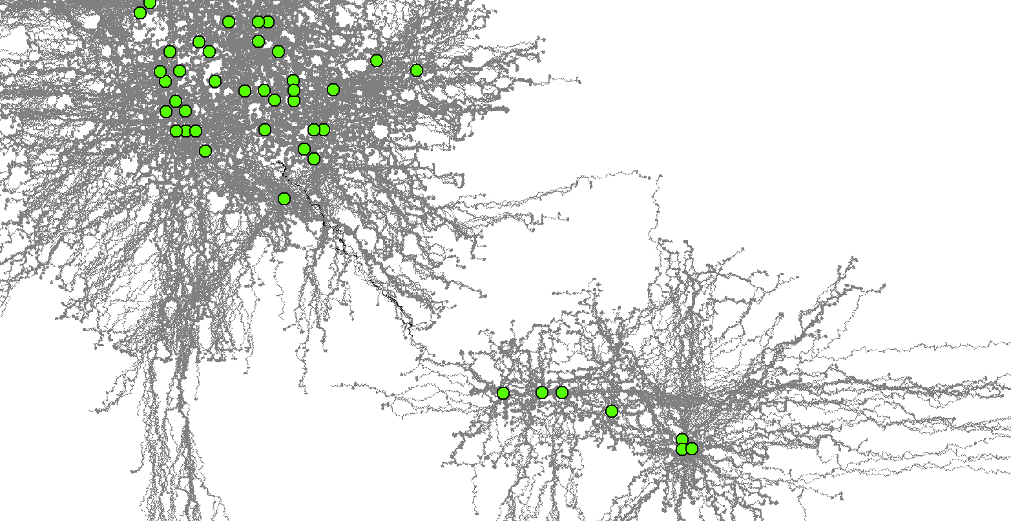
An Agent Based Modelling Approach for Connectivity Estimation

Slide 2
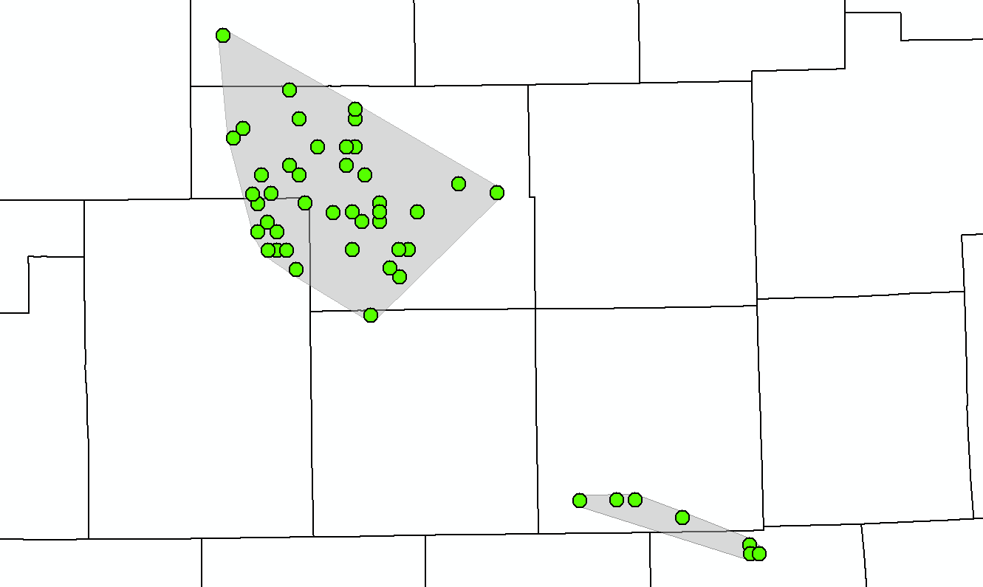
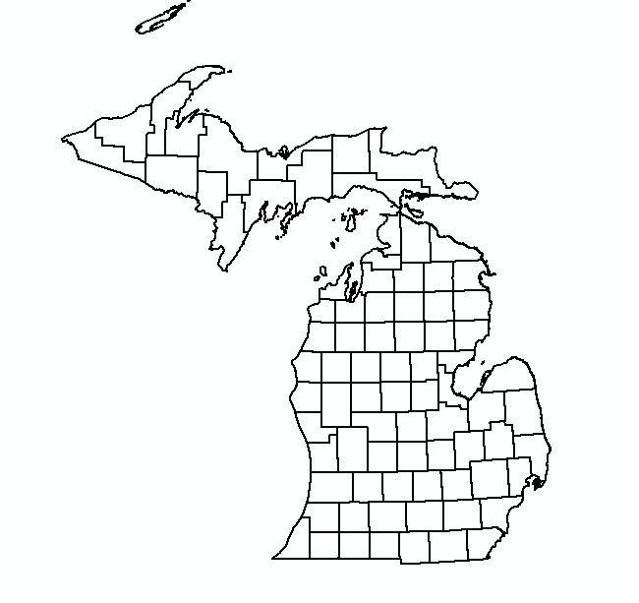
Two zones of disease detection

Slide 3
Two zones of disease detection
Could these zones be functionally connected?

Slide 4
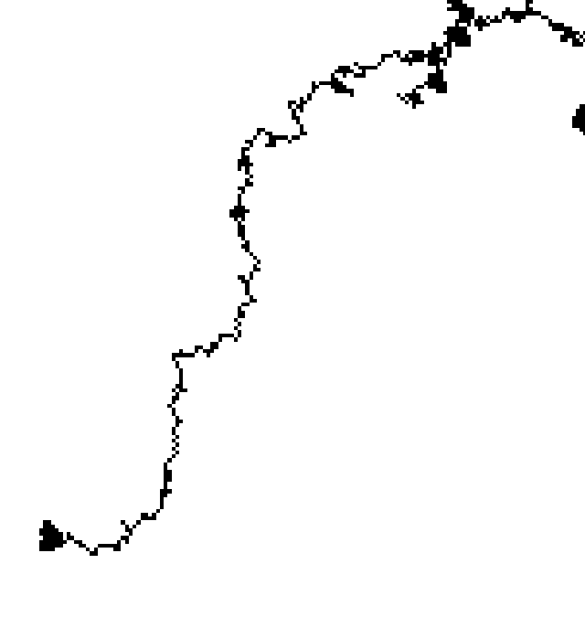

Dispersals as Gateways
Simulate dispersals from CWD detection points
Track the times deer reach opposite disease zone
Index of connectivity between zones

Slide 5
Dispersals as Gateways
Simulate dispersals from CWD detection points
Track the times deer reach opposite disease zone
Index of connectivity between zones

Slide 6
Dispersals as Gateways
Simulate dispersals from CWD detection points
Track the times deer reach opposite disease zone
Index of connectivity between zones

Slide 7
Dispersals as Gateways
Simulate dispersals from CWD detection points
Track the times deer reach opposite disease zone
Index of connectivity between zones

Slide 8
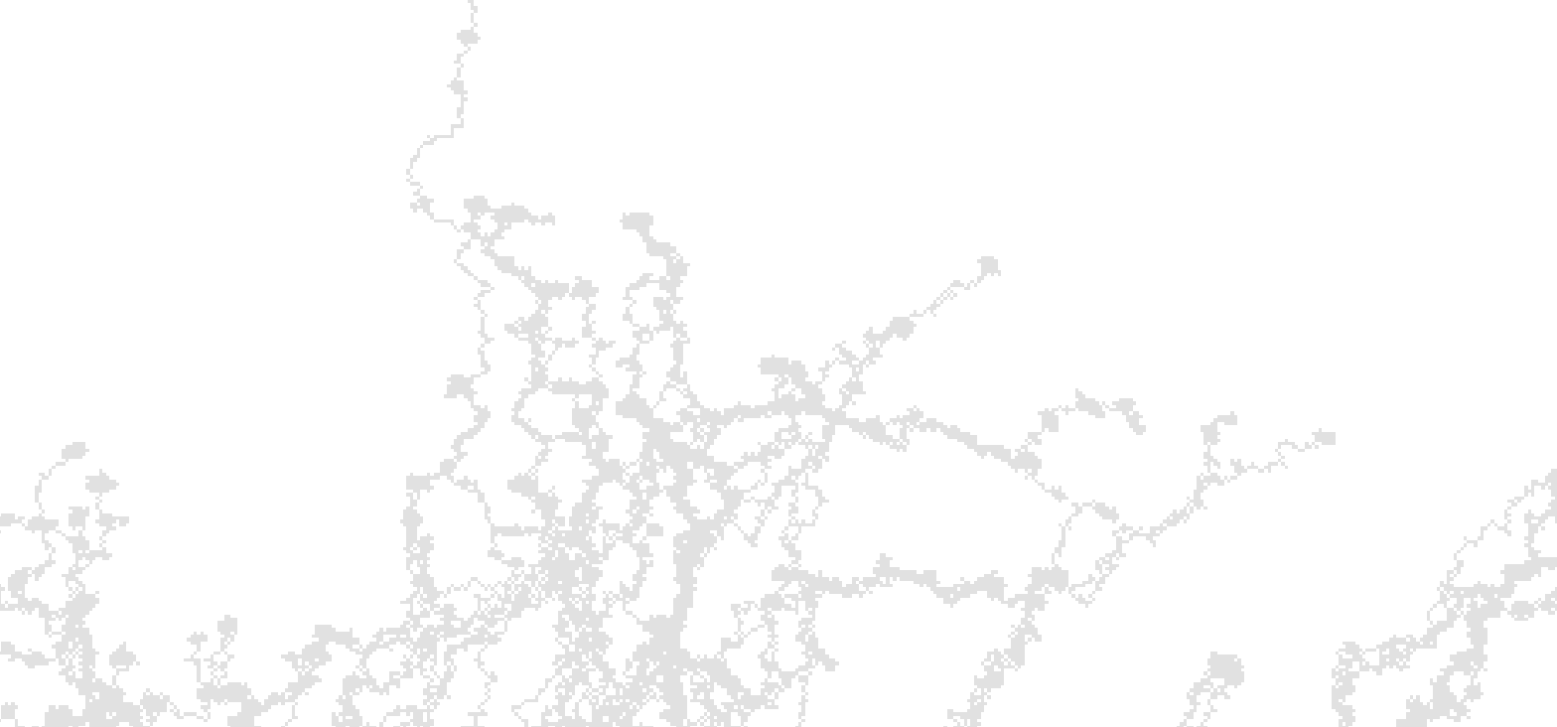
Agents
Yearling male deer
Unique ID
Location
Stochastic Start Point
Preferred Direction
Memory of previous 1 km travel

Slide 9
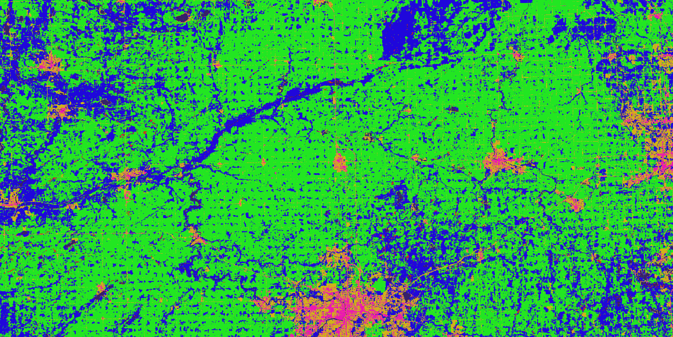
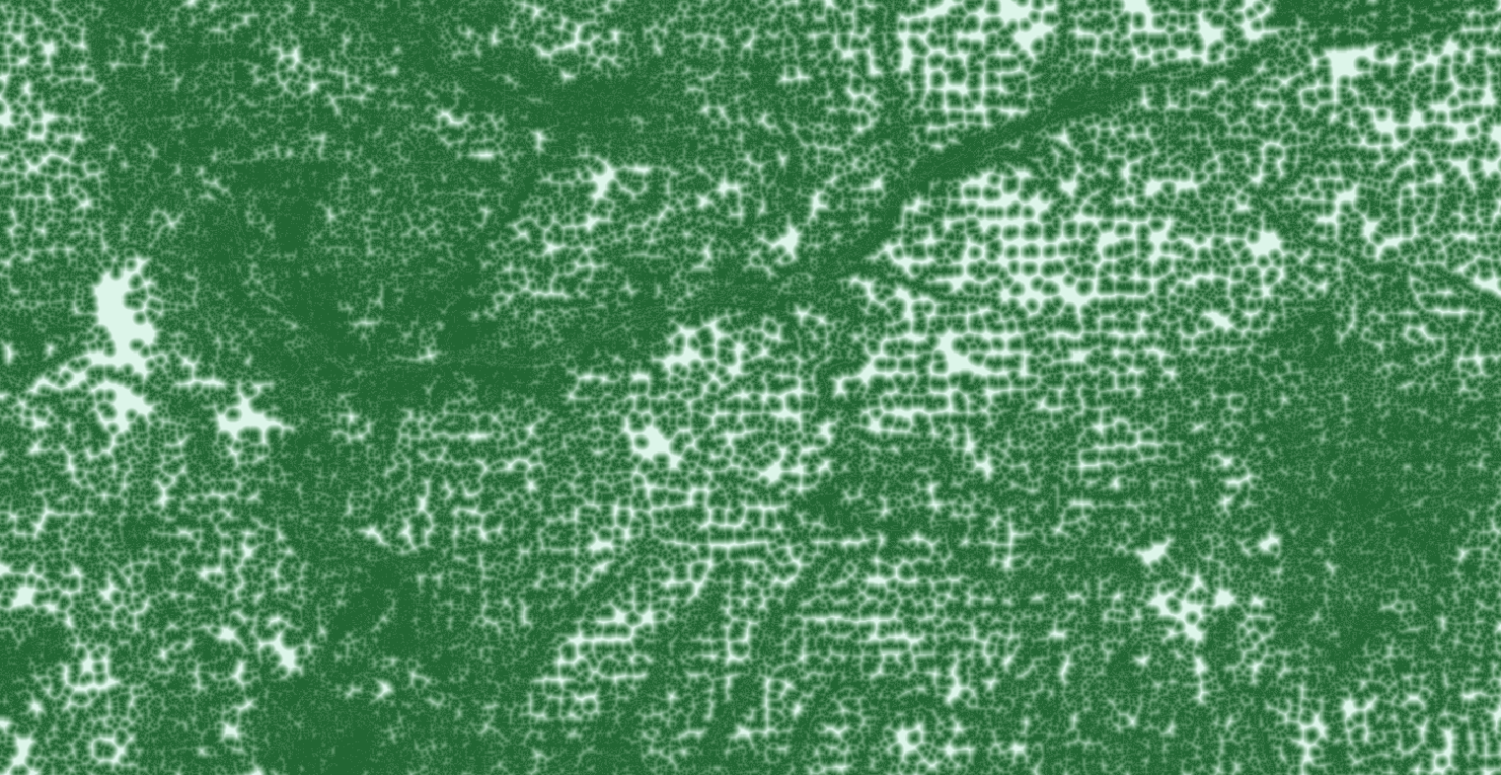
Environment
Raster representation
Landscape features
Land Cover Type
Distance to forest

Slide 10
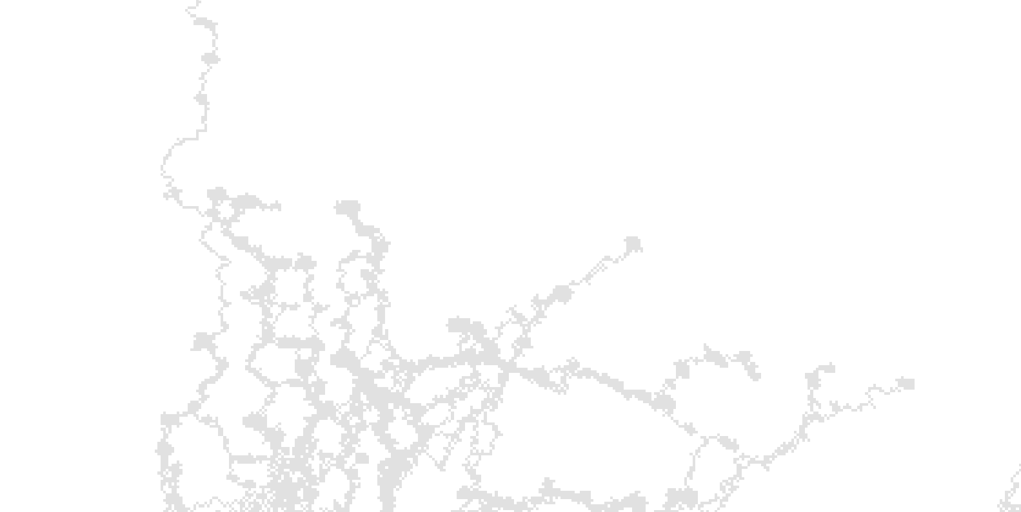
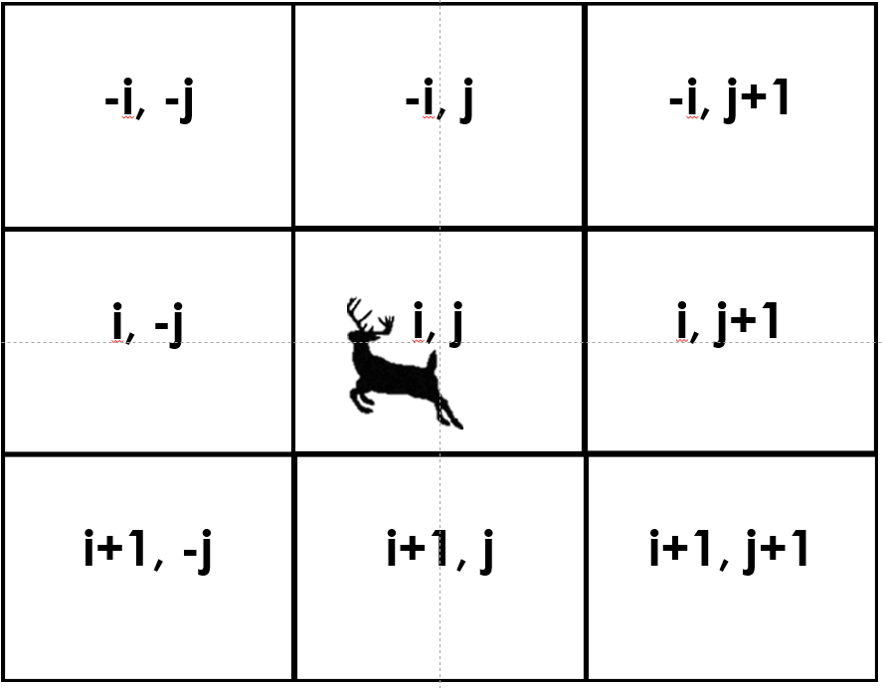
Movement
Raster based movement rules
Deer can move to any nearest neighbor

Slide 11
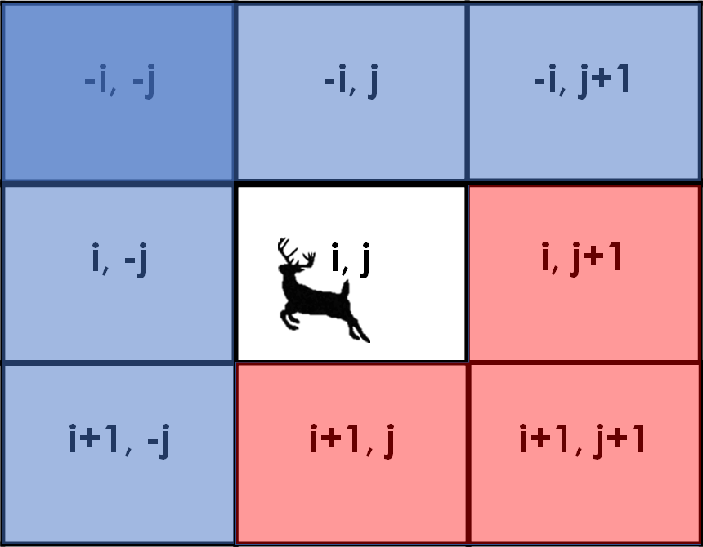
Movement
Raster based movement rules
Deer can move to any nearest neighbor
Directionally biased

Slide 12
Cell Suitability
Land Cover
Discrete probability of movement by cover type
Forest | 1.0
Agriculture | 0.8
Emergent Wetland | 0.8
Low Urban | 0.5
High Urban | 0.15
Open Water | 0.05

Slide 13
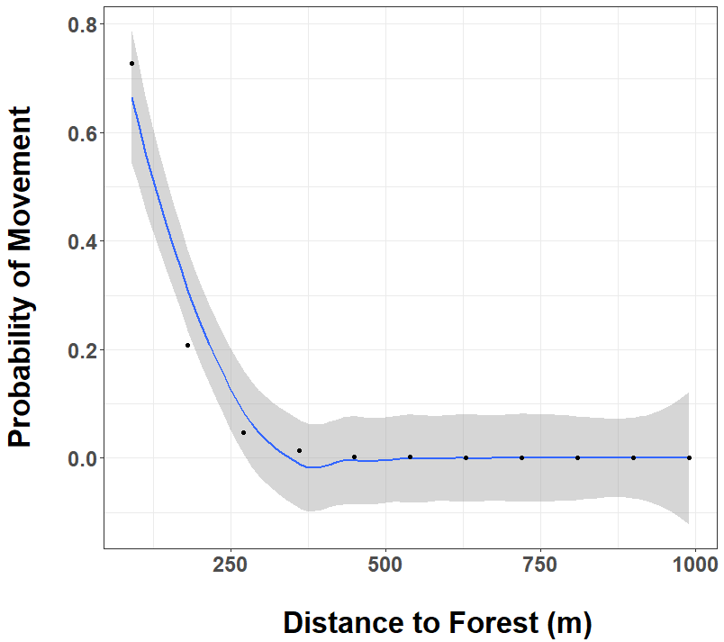
Cell Suitability
Distance to Forest
Exponential Decay
Modelled from NY movement data

Slide 14
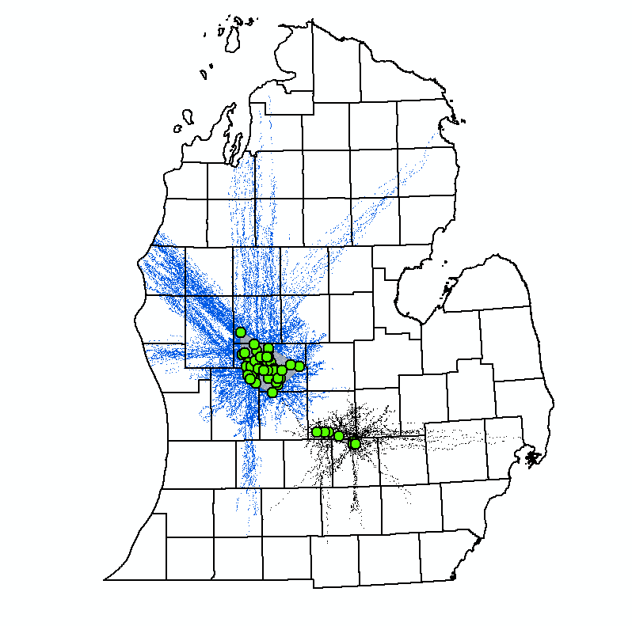
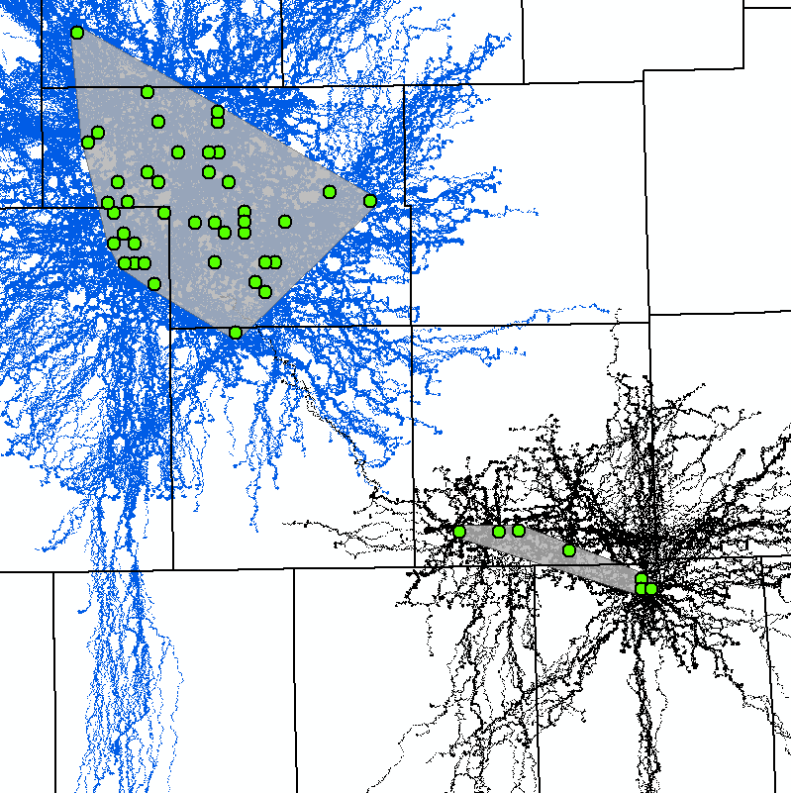

Slide 15
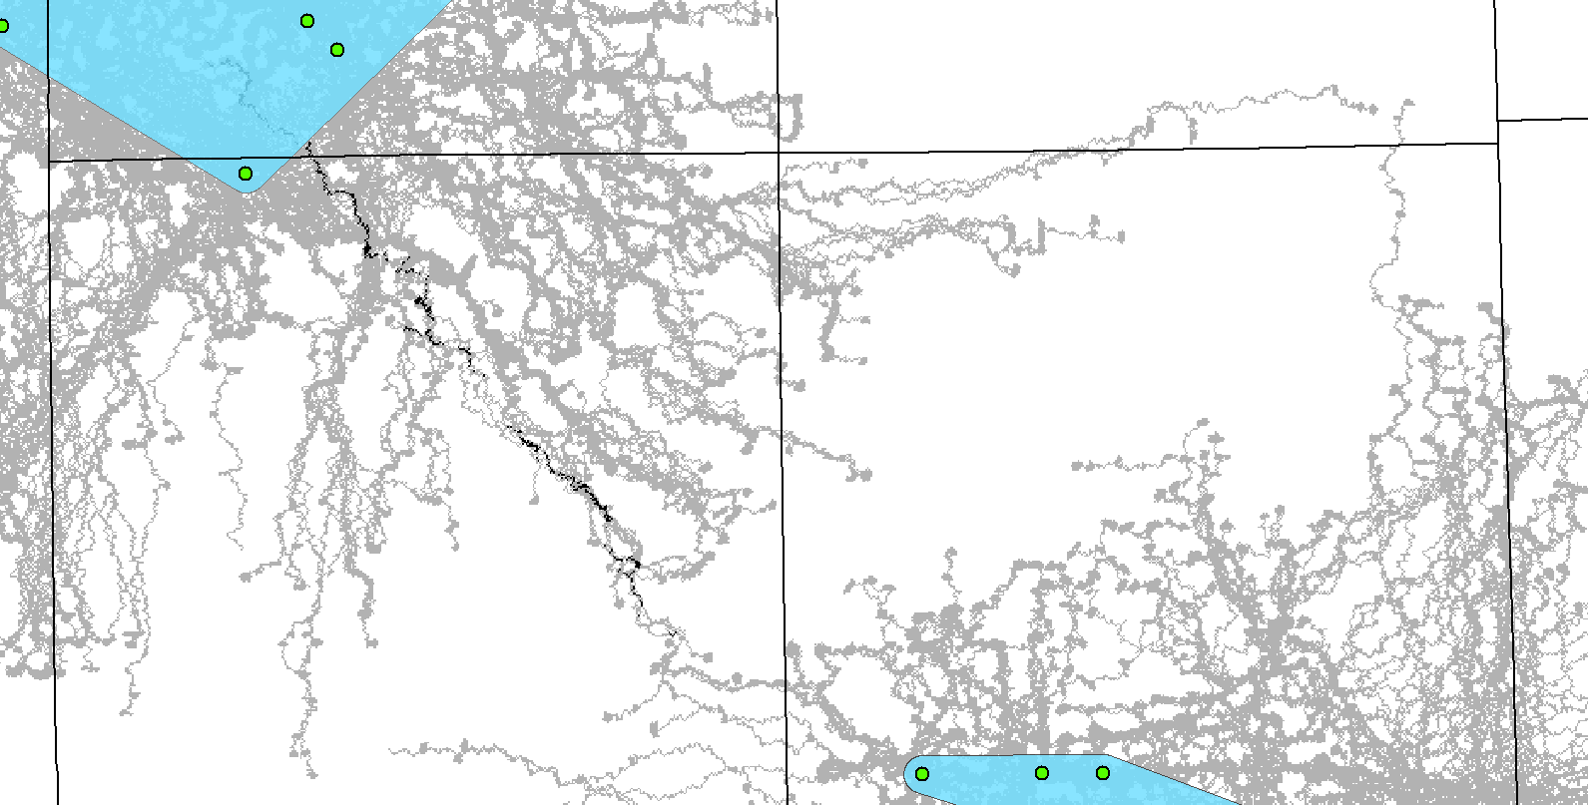
Zonal Overlap

Slide 16
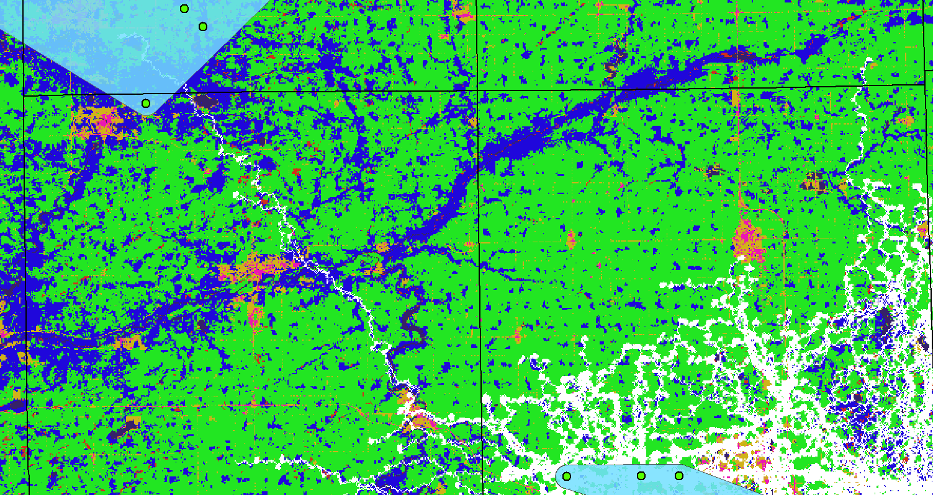
CCAP Overlay

Slide 17
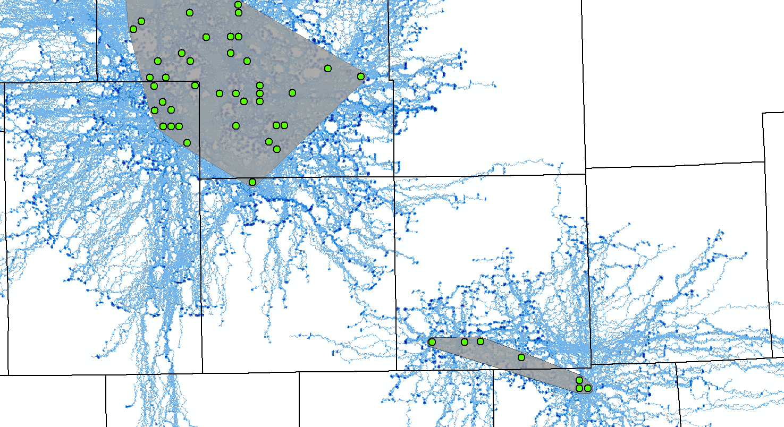
Path Density

Slide 18
Future Directions
Update to continuous movement
Sensitivity analysis (IN PROGRESS)
Simulate across entire study area
Identify corridors?

